Slide 1
Computer Hardware & Software
IS 340

Slide 2
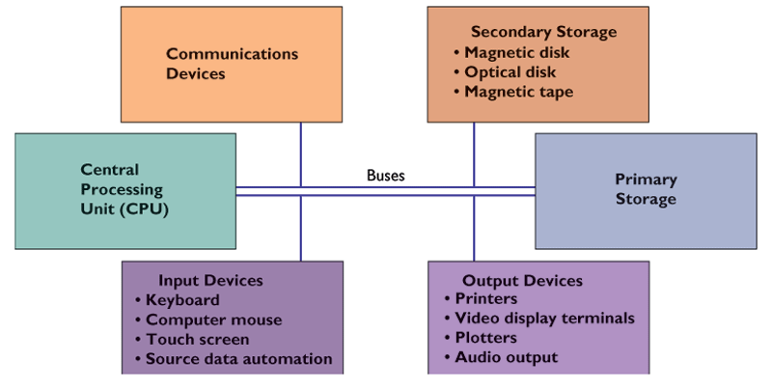
Hardware

Slide 3
Input devices
Keyboard and mouse
Touch screen
Optical character recognition
Magnetic ink character recognition (MICR)
Pen-based input
Digital scanner
Audio input (speech recognizer)
Sensors
Radio-frequency identification (RFID)

Slide 4
Source Data Input Devices
Source data input devices: copy data directly from source
Bar-codes, credit cards, and checks
Use optical recognition devices, which detect positions of marks or characters
Magnetic-ink character recognition: detects magnetic ink on checks

Slide 5
Output devices
Cathode-ray tube (CRT)
LCD
Printers
Audio output

Slide 6
The Central Processing Unit (CPU)
Controls other parts of computer
Arithmetic-logic unit (ALU) performs principle logical/mathematical operations
Control unit (CU) coordinates other parts, such as reading a stored program
Old technology: primary memory was a part of CPU

Slide 7
Primary Storage (internal memory)
RAM (random access memory): Used for short-term, temporary storage (volatile)
Temporarily Stores data and program is using
For user to manipulate
ROM (read-only memory): Semiconductor memory chips with program instructions
Stores operating system software
Not for user to manipulate

Slide 8
Secondary Storage Technology (external memory)
Used for relatively long-term storage of data outside CPU
Magnetic disk: floppies, hard disks,
Optical disk: CD-ROM, CD-RW, DVD
Flash memory (jump disc)
Magnetic tape (slow speed, large capacity, less expensive, for back-up purpose)

Slide 9
Multiple users storage systems
Storage area network
A separate network from company’s LAN
Storage and transfer data

Slide 10
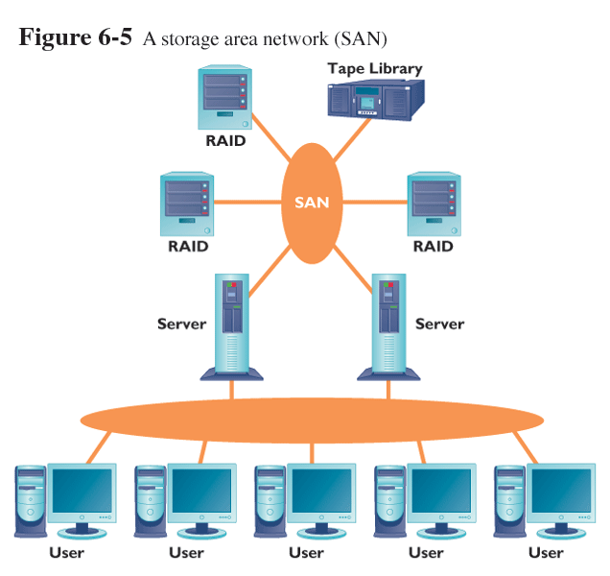
Storage area network

Slide 11
Modes of Access
Sequential access: data is organized one record after another
Slower and less convenient
Using tape
Direct access: records are organized by physical address on the device
Using disk, CD…

Slide 12
Modes of Access
Figure 4.6: Sequential and direct access

Slide 13
Computer processing speed
Speed depends on:
Data word length (number of bits processed at one time)
I/O speed: amount of data that can be moved between devices;
Machine cycle (cycle speed) (MHz) -Fetch, decode execute, and store
RISC (reduced instruction set computing) increases speed; used for scientific, workstation computing

Slide 14
Processing (batch vs. online)
Batch Processing
Accumulates and stores transactions in group or batch until time to process them
Found primarily in older systems for occasional reporting
Use tape storage
Online Processing
Transactions processed immediately
Use disk storage

Slide 15
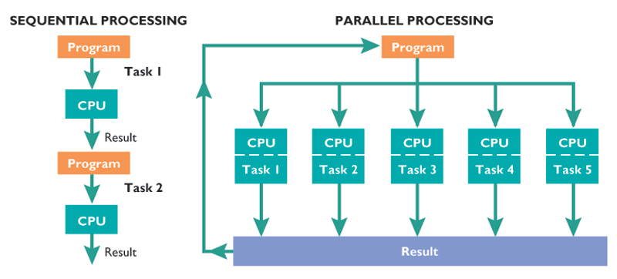
Processing: Sequencing VS. Parallel processing

Slide 16
Multithreading
Modern processors can do multithreading
Processing more than one program at a time (Intel Pentium 4)

Slide 17
Classification of Computers
Classified by power and size
Depends on processing speed and memory size
More powerful computers are more expensive
Supercomputer, mainframe, midrange, micro (notebook, tablet, PDA).

Slide 18
Supercomputers
Supercomputers: most powerful computer at any given time
Largest in physical size and most expensive
Can do parallel processing

Slide 19
Mainframe Computers
Mainframe computers: store large amounts of data and business transactions
Less expensive and less powerful than supercomputers
Banks, universities, and insurance companies use them as a central computer
40-50% of world’s business data resides on mainframes
Use multiple processors

Slide 20
Midrange computers
often act as servers within organizations or through the Internet
Smaller and less powerful than mainframes
Serves hundred of users that connect from personal computers
Use multiple processors

Slide 21
Microcomputers
Microcomputers: personal computers, notebook computers, and handhelds
Workstation: more powerful microcomputer used for CAD, CAM, and scientific applications

Slide 22
Computers on the Go: Notebook, Handheld, and Tablet Computers
Notebook computer: compact personal computer powered by rechargeable battery
Netbook
Personal digital assistant: handheld computer
Stylus used to enter data through touch screen
Tablet computer: PC on a thick writing tablet
(iPad) //www.apple.com/ipad/gallery/ads.html#ad-electric

Slide 23
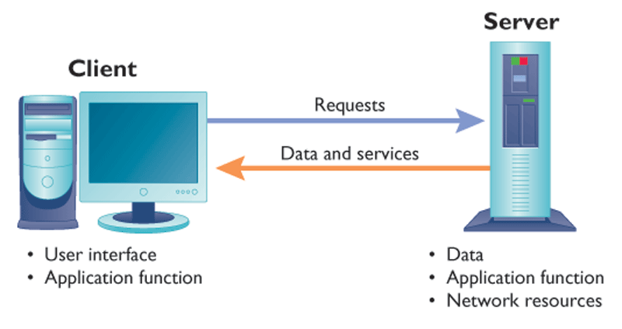
Client/server computing systems

Slide 24
Business Considerations in Evaluating Storage Media
When purchasing storage devices managers must consider:
How the data is used
Capacity of the device
Speed and cost
Reliability and portability

Slide 25
Converging Technologies
Technology convergence: build several technologies into single piece of hardware
Prominent in handheld units
Commonly merged technologies include
Cell phones
Television
Digital cameras
MP3 players

Slide 26
Considerations in Purchasing Hardware
Companies must consider the following when deciding what to purchase:
What do you want?
What software are you going to use?
Power of the equipment
Expansion slots and ports
Monitor type and resolution
Ergonomics

Slide 27
Considerations in Purchasing Hardware (continued)
Other factors include:
Compatibility with existing hardware
Physical size of computer
Reliability of vendor
Power consumption and noise

Slide 28
Scalability and Updating Hardware
Scalability: resources can be expanded or upgraded to provide increased power
Not all hardware is scalable
Leasing hardware is a valid option to avoid short useful lifetime of hardware

Slide 29
Computer Software

Slide 30
Software: Instructions to the Computer
Software categories:
Application software: enables task completion (for certain business purposes)
i.e. payroll software, inventory control software
System software: enables applications to run on computer (to control computers)

Slide 31
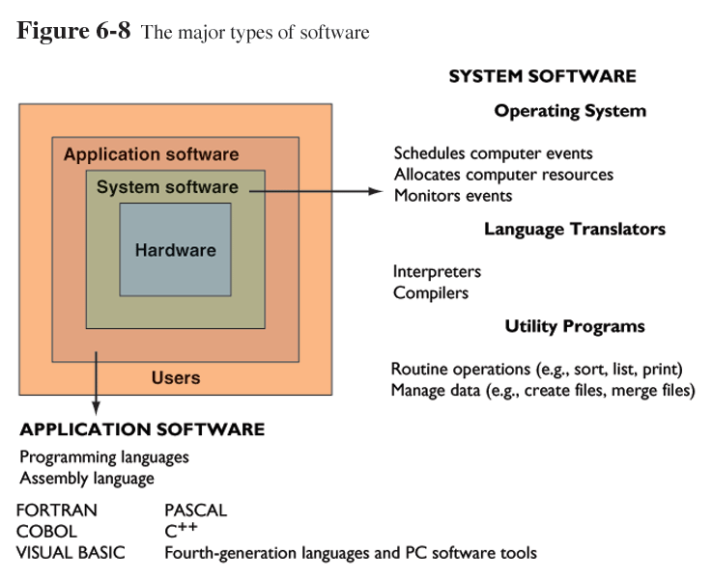
Types of Software
The major types of software

Slide 32
System Software
System software: deals with essential hardware operations (control hardwares)
Application software must be compatible with system software
OS, translators, utilities …

Slide 33
Language Translation: Compilers and Interpreters
Procedural languages need programs to translate source code to object code
Source code: program as originally written
Object code: program in machine language
Two types of language translators:
Compilers : translate all instructions before execution
Interpreters: translate one instruction and then execute it

Slide 34
Operating Systems
Operating system: most important program
Recognizes input from keyboard
Sends output to computer display
Keeps track of files and directories
Runs applications
(a general commander)

Slide 35
Open Source Software
Open source software: free source code
Fewer bugs because many programmers review
Mozilla Firefox
Thunderbird
MySQL
PERL

Slide 36
Open Source Software (continued)
Not all free software is open source
Microsoft Internet Explorer
Linux best known open source operating system
Popular because of versatility
Runs on:
Mainframes
Handhelds
Electronic devices

Slide 37
Utilities: another OS functions
Hardware diagnostics
Disk check
File sorting

Slide 38
Considerations for Packaged Software
Many goals and custom requirements during development process
Factors when purchasing large software packages (more complex)
Cost
Time to implement
Cost of interrupting operations
Modification costs

Slide 39
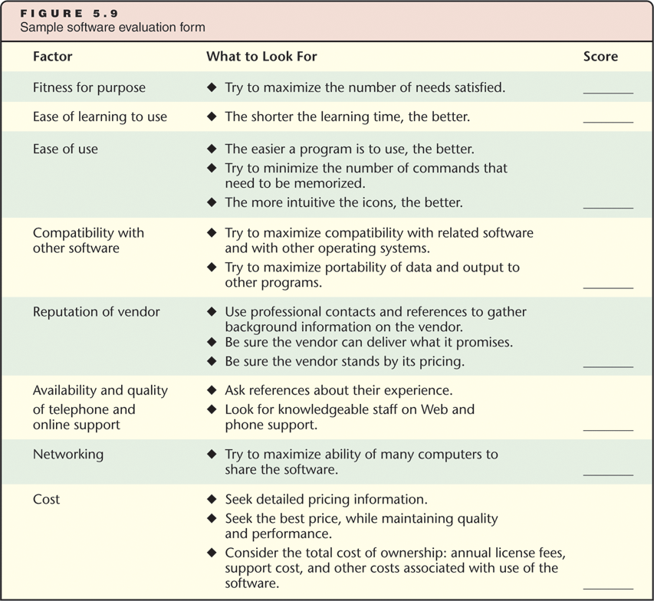
Considerations for Packaged Software
Figure 5.9: Sample software evaluation form

